Slide 1
Travel Worse
project
travelbetter.app

Slide 2
Test team
Team Lead
1
3
Testing Engineers
Ilya Dyuzhev - Coordinated the testing group
Ekaterina Drabskaya
Testing Engineers
2
4
Testing Engineers
Irina Milushkina
Ilona Viktorchyk
Test Manager:
Anton Rapinchuk - Coordinated the team's work on the project

Slide 3
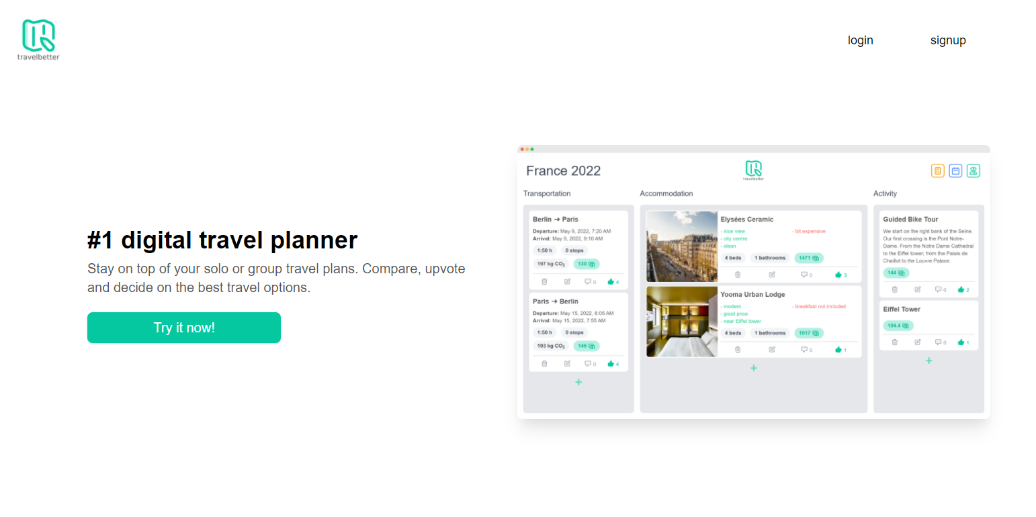

Slide 4
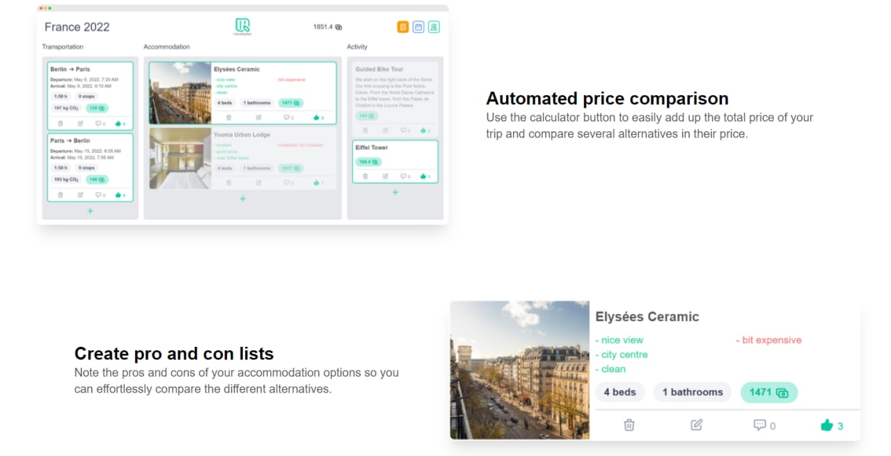

Slide 5
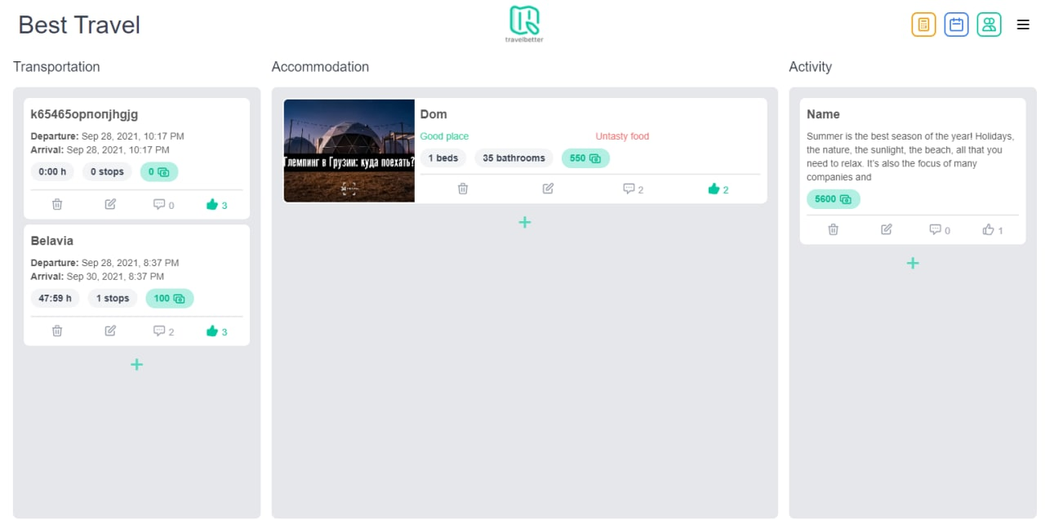

Slide 6
Functionality for testing
The basic functionality was to be tested:
Features not to be tested:
 | Creating a trip plan Adding sections to a trip Editing
 | Assigning attributes Deleting Commenting
 | Filling in application fields The ability to share a created trip for viewing and making changes
 | Login form and registration form
 | Calendar for selecting travel dates
 | Counting button

Slide 7
TEST SCHEDULE
01
02
03
04
TEST STRATEGY CREATION
REQUIREMENTS ANALYSIS
TESTING REQUIREMENTS
CREATION OF CHECK-LISTS
05
06
07
WRITING TEST CASES
TESTING AND WRITING BUG REPORTS
THE CREATION OF A FINAL TRR

Slide 8
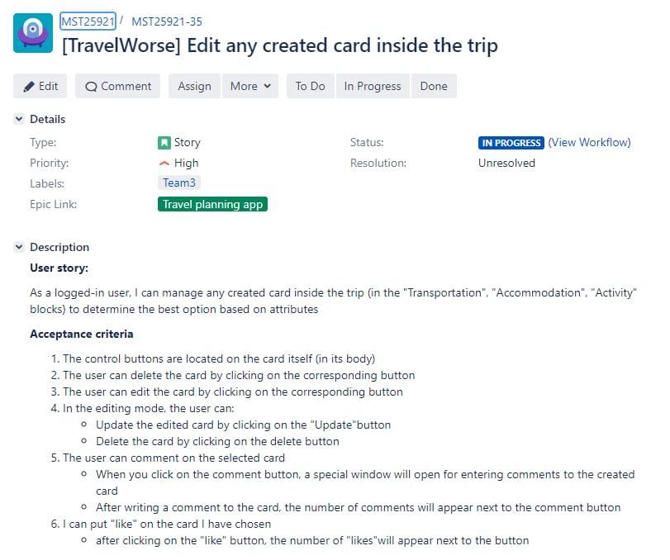
Working with requirements

Slide 9
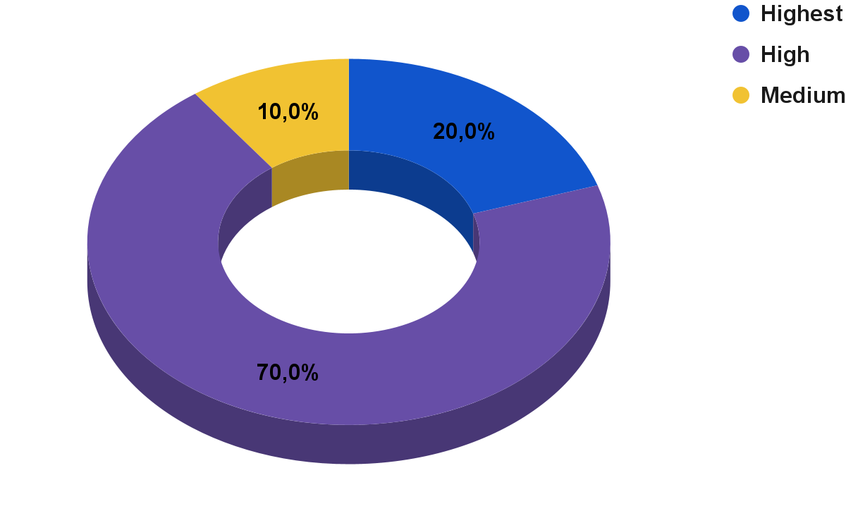
The requirements presented in the form of a user story were divided by priority
Notes:
Highest:
The ability to share the trip plan with friends
Creating a new trip

Slide 10
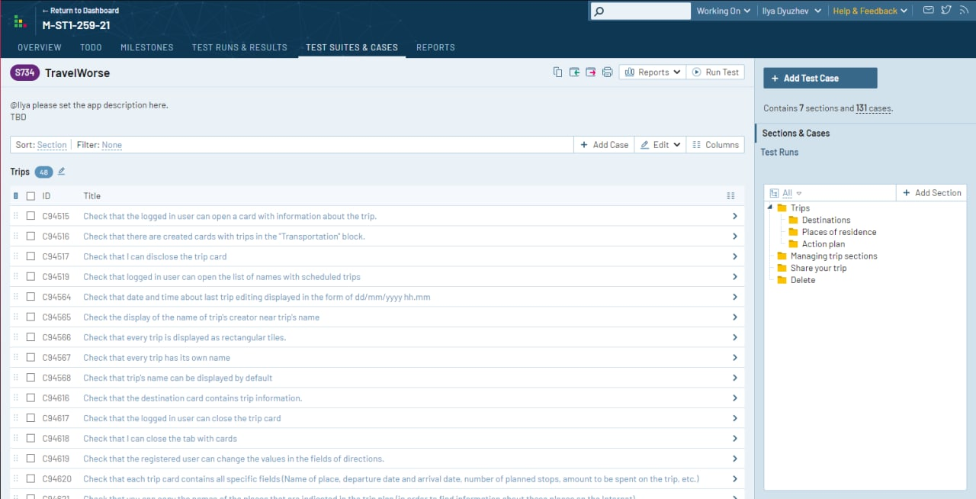
CREATION OF CHECK-LISTS

Slide 11
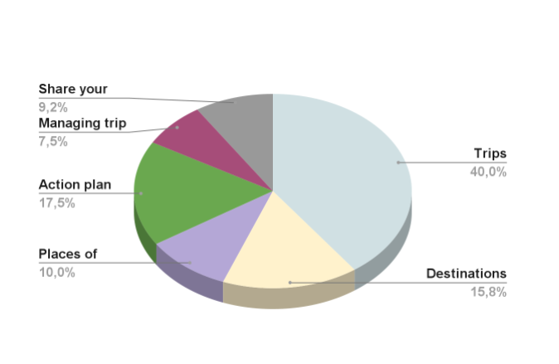
By sections, the test cases were divided

Slide 12
Functional testing levels
1
2
3
THE SMOKE TEST
CRITICAL PATH TEST
EXTENDED TEST

Slide 13
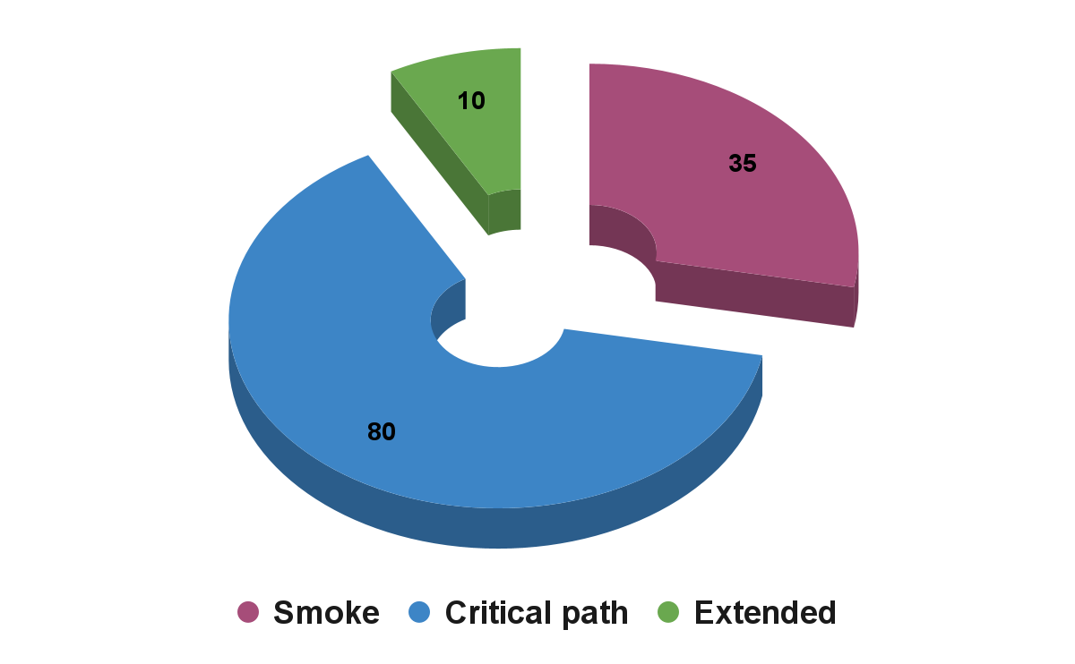
By the level of functional testing, checklists were divided as follows:

Slide 14
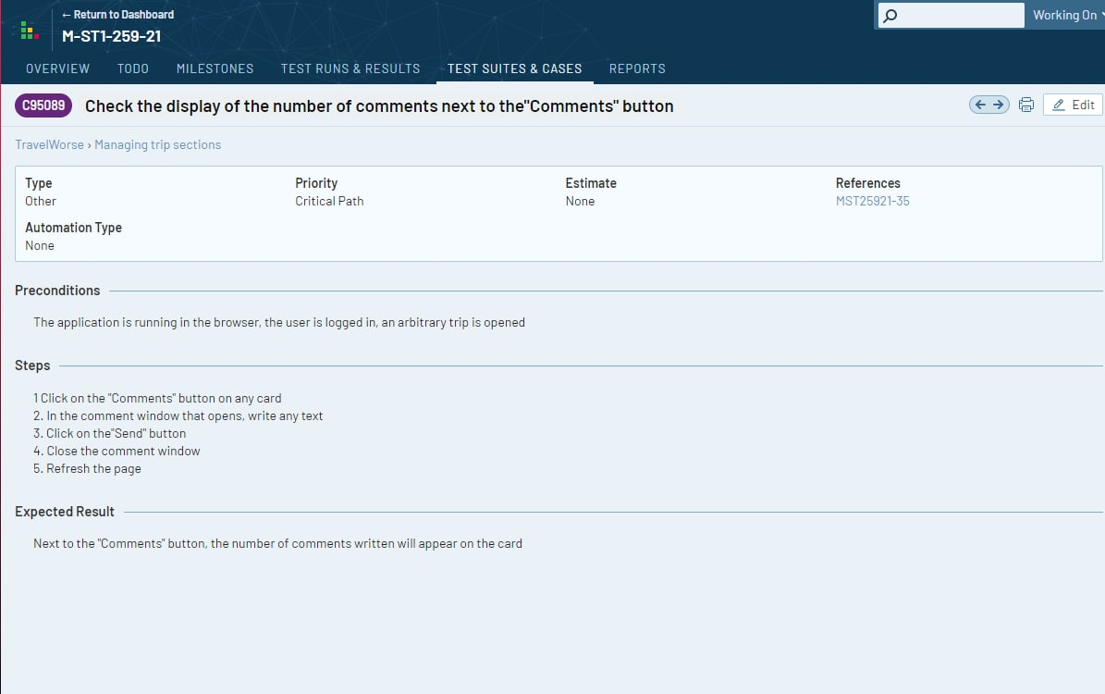
WRITING TEST CASES

Slide 15
Test methods
Black box
Manual functional testing
Use the browser console

Slide 16
The following types of non-functional testing were used:
GUI
Ad hoc
Compatibility
Exploratory

Slide 17
Testing was carried out on three configurations:
Windows 10 Enterprise x64 (Mozilla 92.0.1.)
Android 11 (Google Chrome 94.0.4606.61)
Windows 10 Home x64 (Google Chrome 94.0.4606.61)

Slide 18
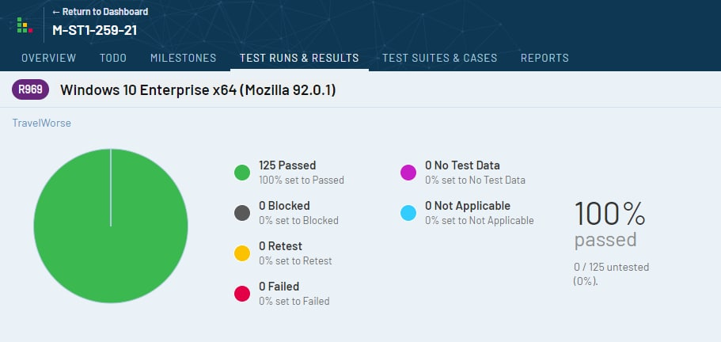
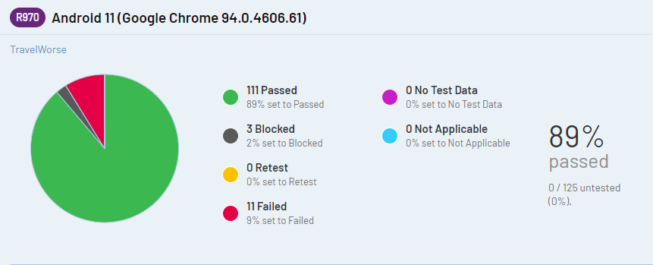
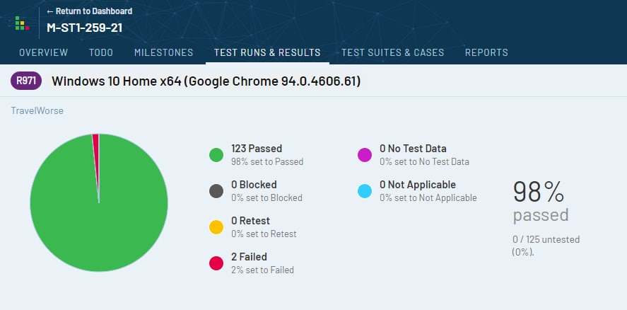
Test results

Slide 19
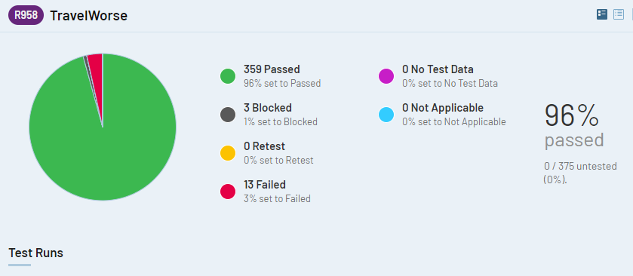
Test results

Slide 20
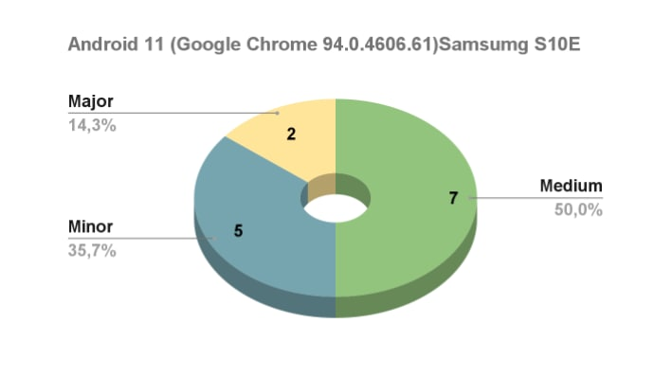
Bug severity definition

Slide 21
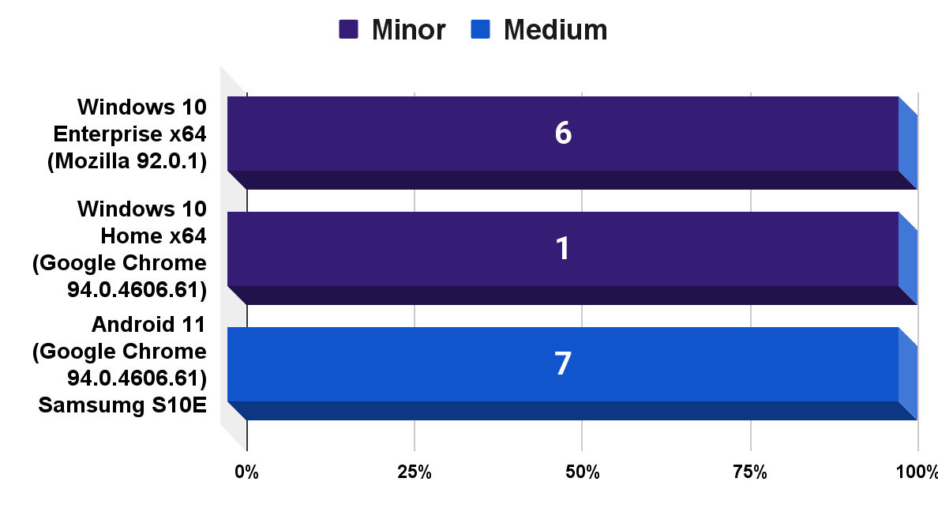
Bugs found by the exploratory method

Slide 22
Thank you for the attention!
Plan your trips with us :)
travelbetter.app testers team
SEPTEMBER
SUN
MON
TUE
WEN
THU
FRI
SAT
1
2
3
4
5
6
7
8
9
10
11
12
13
14
15
16
17
18
19
20
21
22
23
24
25
26
27
28
29
30
31

